Slide 1
Research Synthesis Presentation Creator
Group 19: Vien Nguyen and Sheng Rao
April 2026

Slide 2
Project Goals
Make something we would use ourselves
Agentic AI concepts
Academic Papers extremely relevant to students
Slide Presentations as Summary
Retrieval Augmented Generation
Dynamic model routing (LiteLLM)
Agent trace logging (LangFuse)
Actor / Critic Agentic Workflow (LangGraph)
Student Friendly
System technologies
No expensive AI inference cost and document intelligence
S3 Cloud Storage
LlamaParse cloud PDF parsing

Slide 3
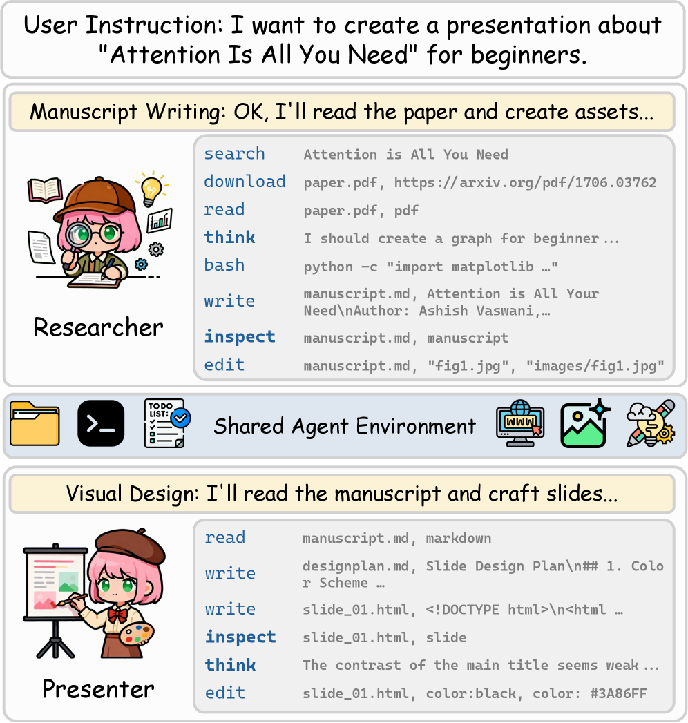
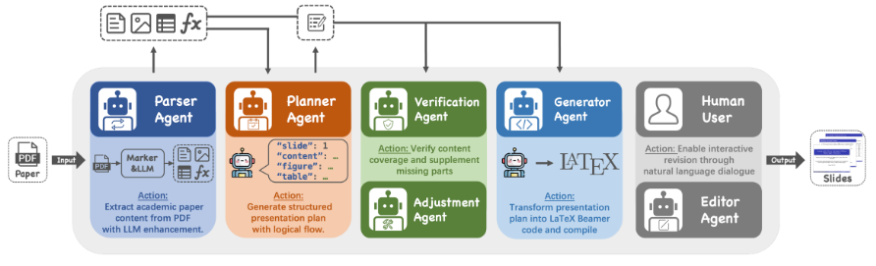
Related Work and
Existing Limitations
DeepPresenter
(Y. Yang et al. Feb 2026)
Auto-Slides
(H. Zheng et al. Sep 2025)
Local Marker AI model for PDF parsing
Verification and Adjustment agents, but none for narrative coherence or layout
No user input at the start, only at the end
Output to Beamer/PDF
Custom fine-tuned model
(DeepPresenter-9B)
Single Presenter agent iterates on slides
AI image generation
Output to HTML

Slide 4
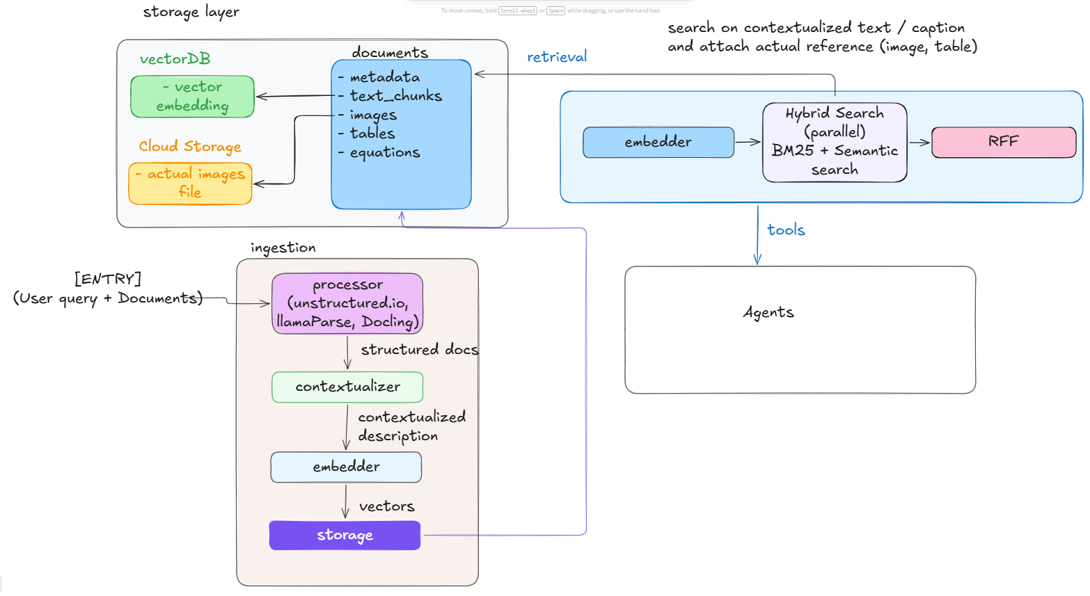
Document processing
Ingestion
Agentic processing with LlamaParse
Contextual retrieval (Anthropic idea)
Embedding
Storage
Retrieval:
Agent calls tool
Hybrid strategy with BM25 and Semantic Vector Search
Reciprocal Rank Fusion

Slide 5
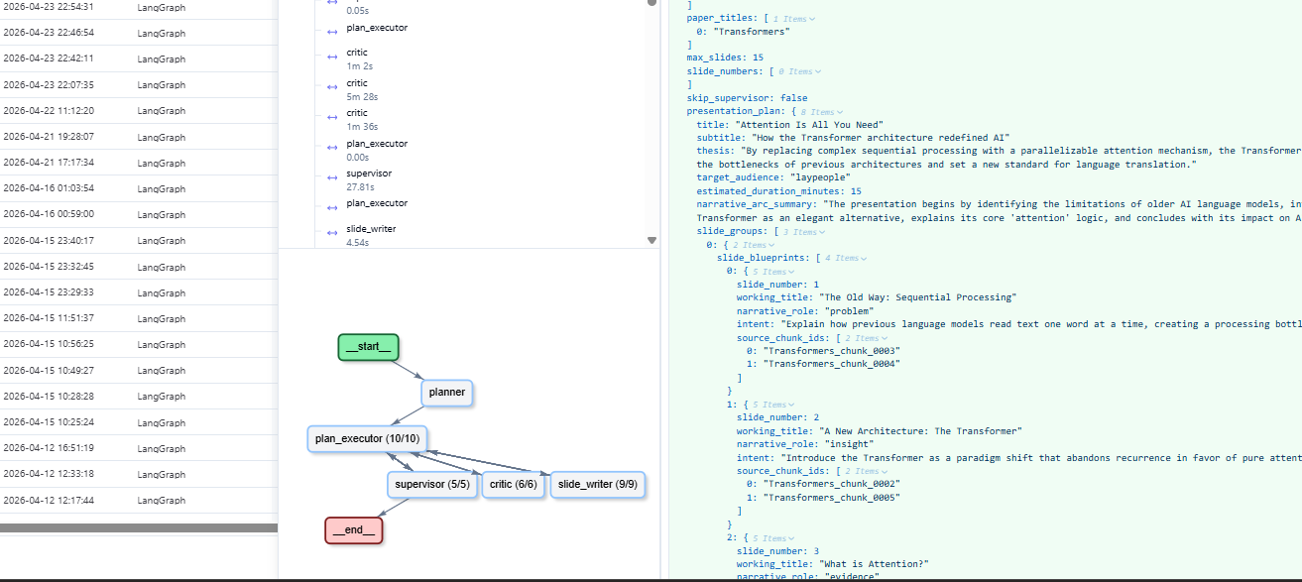
Visibility and up-time
Dynamic model routing with LiteLLM
Support multiple cloud Providers (Ollama, NVIDIA NIM, Gemini API, Azure, OpenRouter)
Layered reliability strategy
LangFuse logging
Graph execution
Internal LLM call

Slide 6
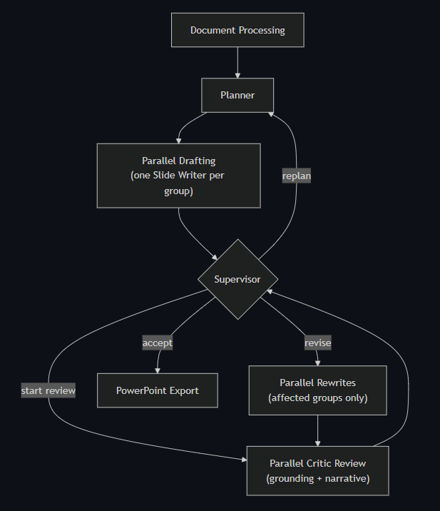
Graph Design
Start -> Document Processing
Planner creates Presentation Plan and Slide Assignments from processed document and user query
Parallel fanout of Slide Assignments to Slide Writers
Fanout received by Supervisor
Supervisor starts cycle by starting parallel Critic review
Critic reviews received by Supervisor
Supervisor decides to accept, revise, or replan the deck
If Replan: Restart the graph by going back to the Planner in Step 2
If Accept: End cycle and export to Powerpoint
If Revise: Send out parallel Slide Writers to rewrite specific slides.
After Slide Writers complete, start a new round of Critic reviews.
After Critic reviews, go to Step 6, continuing the cycle.

Slide 7
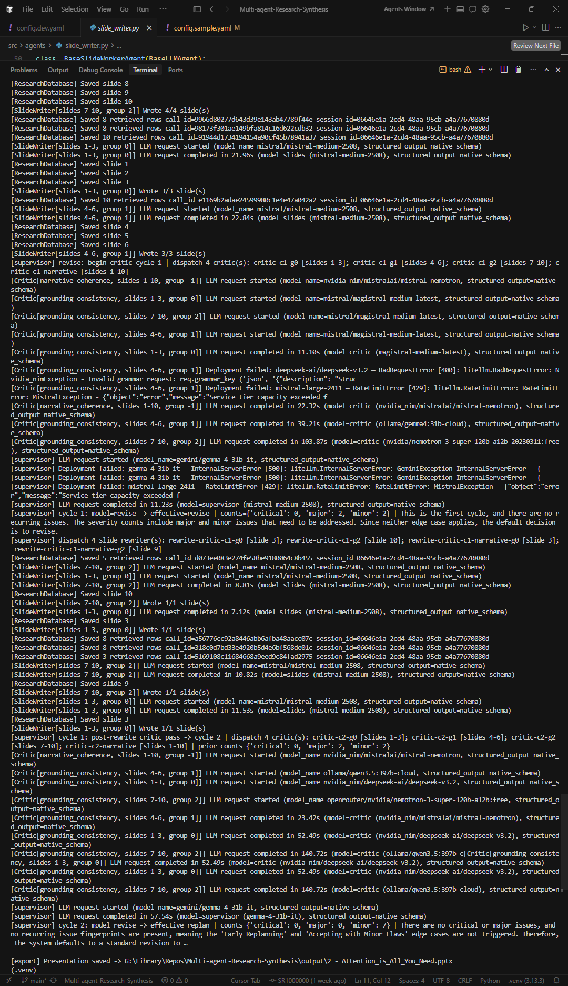
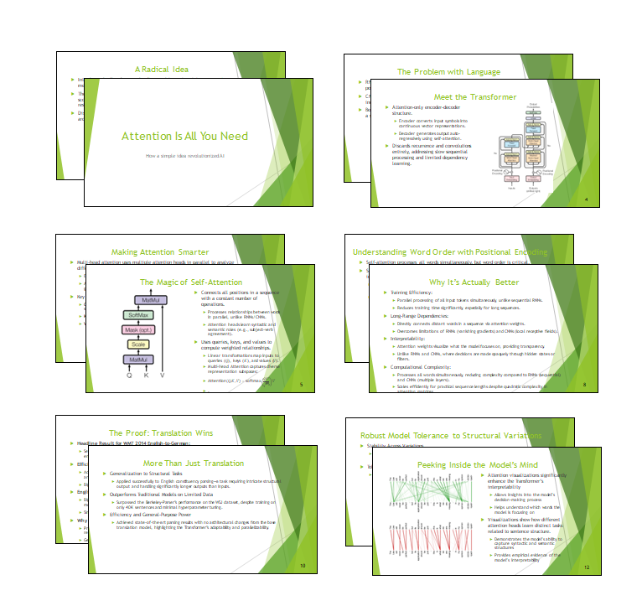
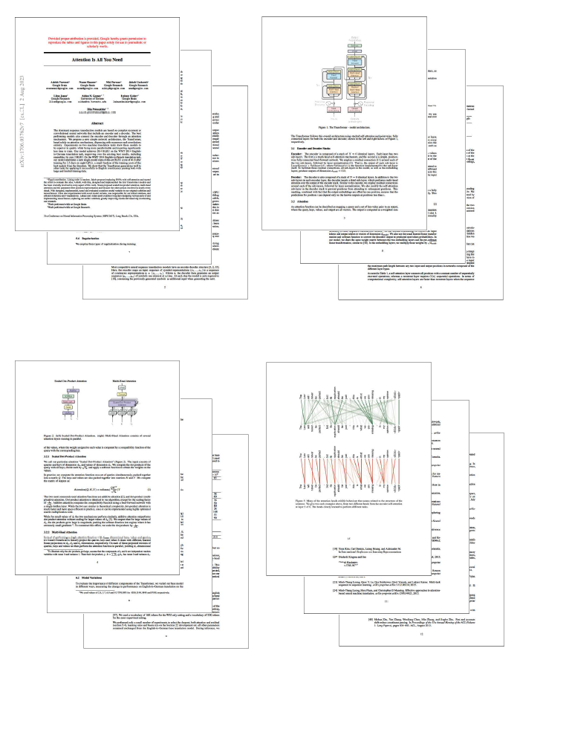
Demonstration
Attention is All You Need Paper
Processing…
Slide Deck Final Output

Slide 8
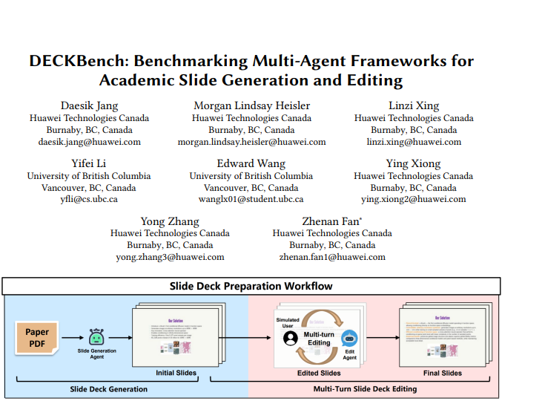
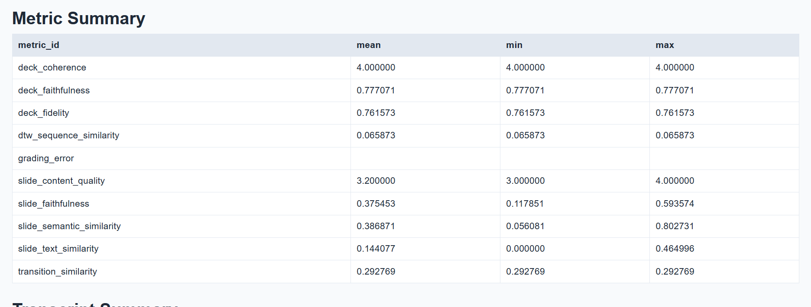
Evaluation
Positive signals:
- deck_faithfulness = 0.7771
- deck_fidelity = 0.7616
The deck by itself was reasonably well and close to the benchmark reference
Improvement signals:
- slide_text_similarity = 0.1441
- slide_semantic_similarity = 0.3869
- transition_similarity = 0.2928
- dtw_sequence_similarity = 0.0659
Slide-level content did not match well with reference slide
Notes:
Lastly, we did put together an evaluation pipeline to see how our graph measures
We use deckbench benchmark, which is a collection of research paper, and the human made slide presentation generated from that that paper as a reference.
We measure how well the presentation performed as a whole deck and on slide by slide level, and with or without reference to the human made deck
Overall, the trong signals was that our graph as a whole was very consistent, it has good transitions and coherence, and it stayed true to the input document thanks to the RAG pipeline and critics agent
The less positive signals came from the individual slide level. The benchmark use Hungarian matching algorithm to match output slide to its most semantically similar slide in the reference bench, and by itself we stray a bit from r

Slide 9
References
Hao Zheng et al. “DeepPresenter: Environment-Grounded Reflection for Agentic Presentation Generation.” arXiv:2602.22839v3 [cs.AI], 2026.
Yuheng Yang et al. “Auto-Slides: An Interactive Multi-Agent System for Creating and Customizing Research Presentations.” arXiv:2509.11062v3 [cs.HC], 2025.
Roles and Contributions

Slide 10
Thank you
Questions?

